Slide 1
CHAUDHARY DEVI LAL UNIVERSITY SIRSA-125055, HARYANA, INDIA (Established by the State Legislature Act 9 of 2003)
UNIVERSITY SCHOOL FOR GRADUATE STUDIES
Prof. Ajmer Singh Malik Prof. Sushil Kumar
Vice Chancellor Dean
www.cdlu.ac.in 2021-22 cdluadmissions.ac.in

Slide 2
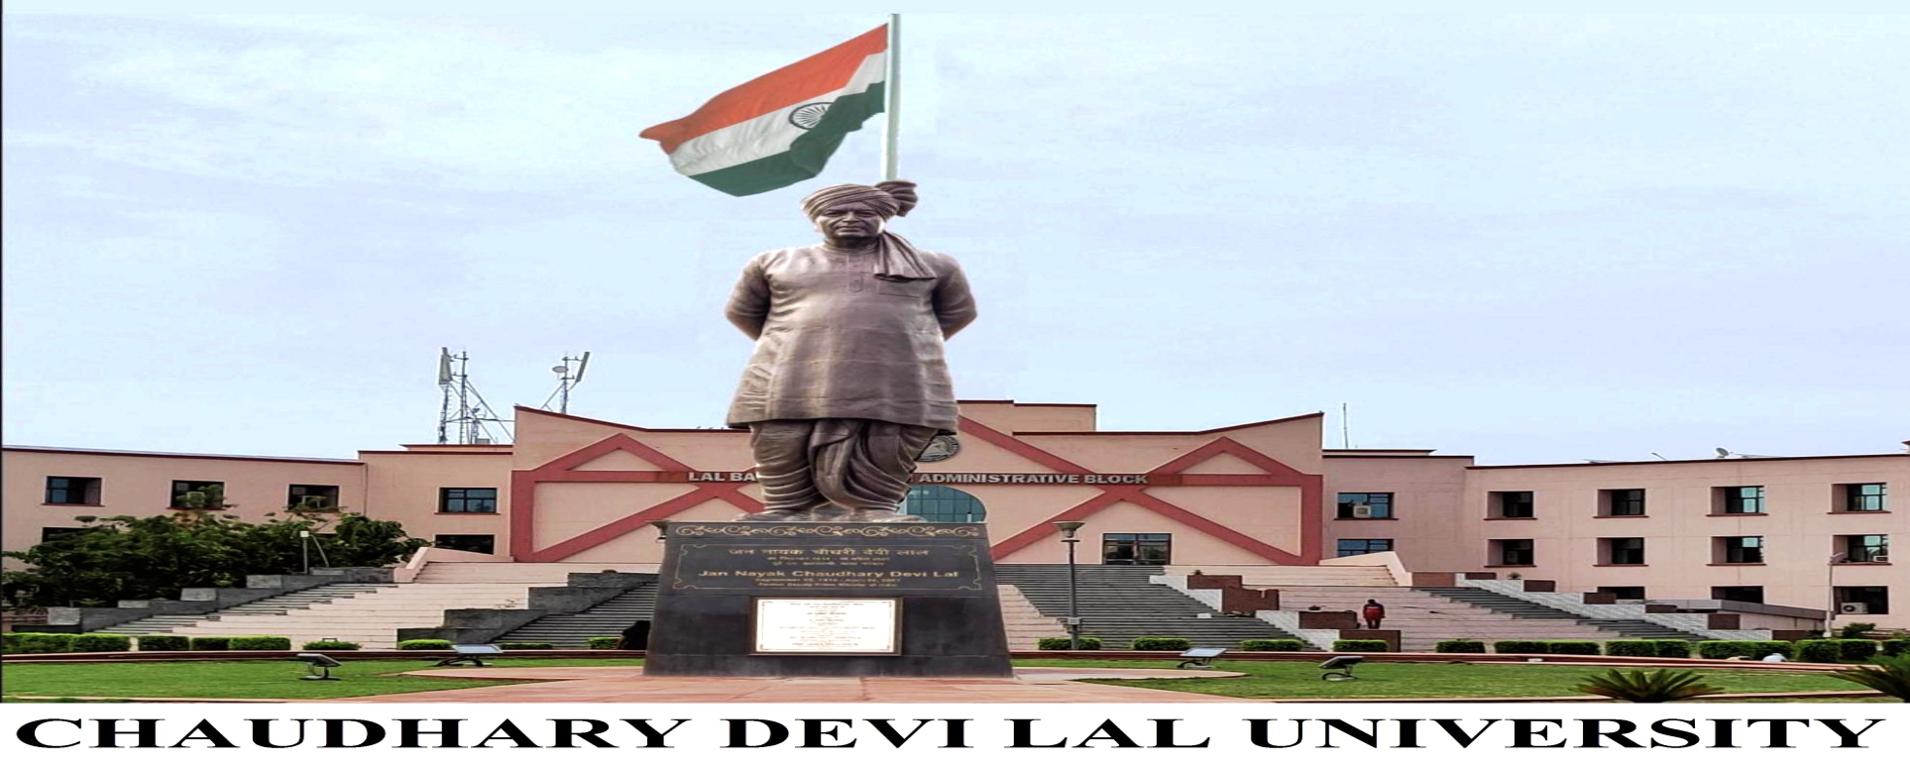

Slide 3
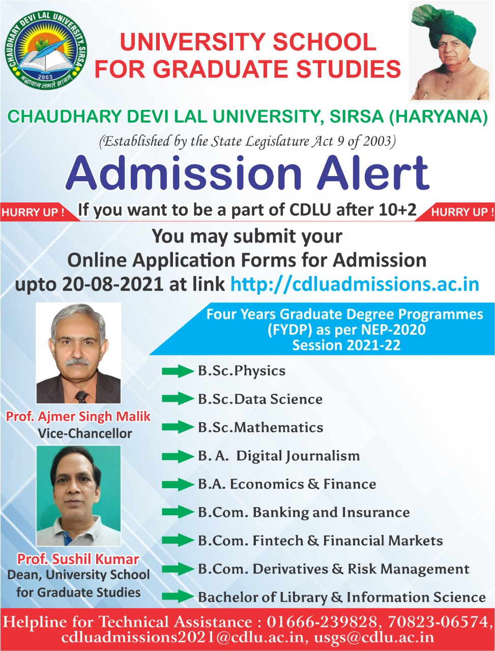

Slide 4
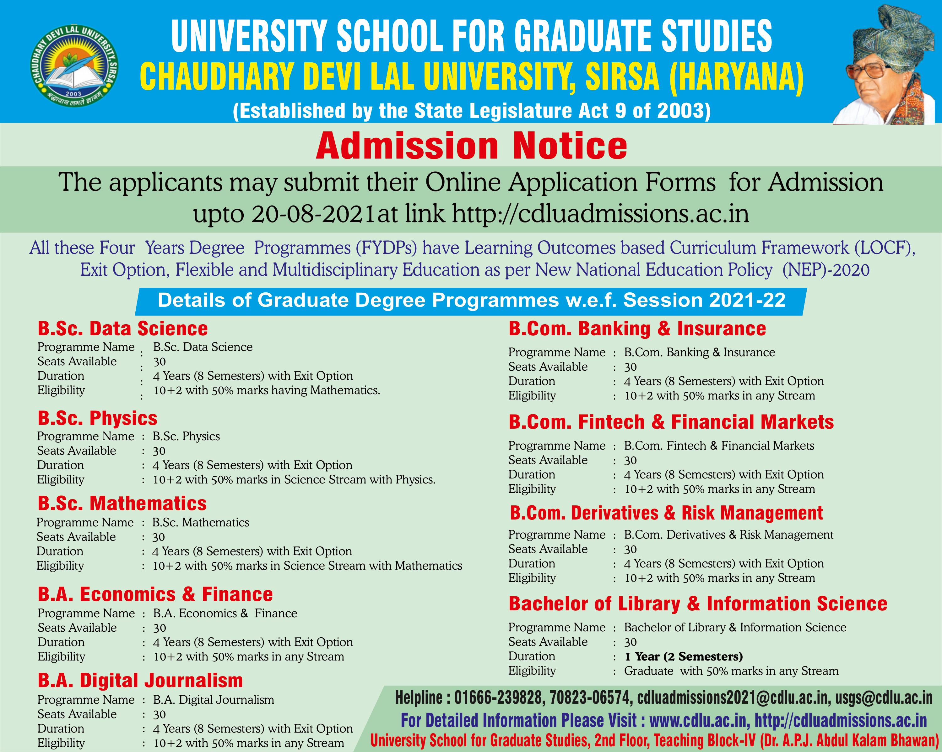

Slide 7
B.Sc. Physics
Objectives of the Programme:
To motivate/inspire the students to inculcate deep knowledge and understanding of concepts, principles and theories/experiments of Physics.
To make strong foundation in Basic and Applied aspects of Physics in order to develop professional skills to solve problems of Physics having applications in the real world.
To undergo research in interdisciplinary areas Physical Sciences, technical jobs in scientific and industrial sectors, and teaching career in Physics.
Job Opportunities:
Consultant Physicist
Physics Lecturer/Professor
Scientist/ Scientific Assistant
Research Associate/ Project Assistant
M.Sc./M.Tech./Ph.D.
Lab. Technician/Assistant/Supervisor
Academic Counsellor/Tutor
Physics Content Developer
Subject Matter Expert
Quality Control Manager
Radiation Physicist/Oncologist
Industry Entrepreneur

Slide 8
B.Sc. Data Science
Objectives of the Programme:
To impart deep knowledge and technical skills of Data Science to the students.
To expose students to Applied Statistics, Data Mining, Data Visualization, Machine Learning, Big Data Analytics, Predictive Modelling.
To produce skilled professionals to understand, collect, extract, analyse and predict the trends of the given set of big data to solve the problems of diverse sectors through real-time data analysis.
Job Opportunities:
Data Scientist
Machine Learning Engineer
Machine Learning Scientist
Data Science Lecturer/Professor
M.Sc./M.Tech./Ph.D.
Applications Architect
Business/Enterprise Architect
Infrastructure Architect
Business Intelligence (BI) Developer/Analyst
Statistician/Statistical Analyst
Data Analyst
Data Architect
Web & Social Media Analyst
Data Solutions Analyst
Business Processes Analyst
Client-Related Mechanism (CRM) Analyst

Slide 9
B.Sc. Mathematics
Objectives of the Programme:
To inculcate deep knowledge in the core and discipline specific areas of Mathematics.
To make strong foundation in Pure and Applied aspects of Mathematics in order to develop professional skills to solve mathematical problems having applications in the real world.
To undergo research in different areas of Mathematical Sciences, technical jobs in scientific and industrial sectors, and teaching career in Mathematics
Job Opportunities:
Mathematics Lecturer/Professor
M.Sc./M.Tech./Ph.D.
Research Associate
Mathematics Content Developer
Subject Matter Expert
Scientist
Accountancy & Management
Investment Banking
Machine Learning Engineer
Data Analyst/Data Scientist
Operations Researcher/ Analyst
Financial/Investment Analyst
Statistical Analyst
Actuarial Scientist/Analyst
Accountancy and Professional Service
IT Industry/Entrepreneur

Slide 10
B.A. Economics and Finance
Objectives of the Programme :
To impart deep knowledge with respect to economics theory, practice, planning and implementation, and to develop critical thinking of finance.
To provide interdisciplinary knowledge and to build skill to increase the employability in diverse areas.
To learn/work with multidisciplinary approach in order to set directions and formulating inspiring vision for economic development.
Job Opportunities:
Economics Lecturer/Professor
Economics Content Developer
Subject Matter Expert
M.A./Ph.D.
Finance Management Consultant
Finance Investment Expert
Auditor
Finance Officer/Controller
Economics Consultant
Actuarial Analyst/Economist
Financial Risk Analyst
Finance/Investment Manager
Think tanks in Development Sector
Organisations
Economist in a Corporate Sector
Firm/Company
Management and Finance
Policymaking

Slide 11
B.A. Digital Journalism
Objectives of the Programme:
To impart knowledge with respect to Journalism in general and Digital Journalism in particular; about theory, practice, planning and implementation.
To provide technical knowledge and to build technical skills in students to increase the employability in diverse areas.
To learn/work with multidisciplinary approach in order to set directions/ dimensions, and formulating vision for electronic media’s role in democracy and development.
Job Opportunities:
Advertising Manager
Animator
Art Director
Digital Audio Technician
Digital Graphic Artist
Digital Video Editor
Production Assistant
Online Database Manager
Public Relations Manager
Web Developer/Web Analytics
Digital Imaging Manager
Video Designer and Editor
Illustrator
Social Media Marketing Manager
Web Application Developer
Reporter and Editor in Online Media
Social Media Political Campaign Manager
Citizen Journalist

Slide 12
B.Com. Banking and Insurance B.Com. Fintech and Financial Markets B.Com. Derivatives and Risk Management
Objectives of the Programme :
To enable students to undertake studies in Commerce and its allied areas, and to acquaint them with recent market trends/practices.
To encourage students to develop generic skills helpful in internship, employment and social activities.
To formulate business problems and to provide innovative solutions in order to become compassionate and efficient management leaders.
To provide comprehensive knowledge of Marketing, Business and Corporate Law, Economics, Finance, Accounting, Management, Tax; and other specialized branches such as Banking and Insurance, Fintech and Financial Markets, Derivatives and Risk Management.
Job Opportunities:
Commerce Lecturer/Professor
Commerce Content Developer/Subject Matter Expert
M.Com./Ph.D.
Auditors
Actuarial Analyst
Accountant
Finance Manager/Controller
Financial Analyst
Human Resource Manager
Investment Banker/Broker
Investment Analyst
Budget Analyst/Budget Planning
Banking and Insurance Manager/Consultant
Cyber Security Analyst
Working Capital Management
Foreign Trade Expert
Inventory Control
Product Manager/ Finacial Risk Manager
Fintech Apps Developer
Business Operation/Development Manager

Slide 13
Bachelor of Library and Information Science (B.Lib.I.Sc.)
Objectives of the Programme :
To impart knowledge and understanding of fundamental concepts, principles, and theories related to Library and Information Science.
To equip students with technical skills essential to provide various library and information services using Information and Communication Technology.
To inculcate in students, the professional attitude and ethical values for providing library and information services through self-employment or infopreneurship.
Job Opportunities:
Librarian/Deputy Librarian/Assistant Librarian
Library Information Officer
Professional Assistant
M.Lib.I.Sc./Ph.D.
Library Assistant/Attendant
Research Associate/Project Assistant
Library Information Assistant
Abstractor
Archivist
Cataloguer
Metadata Librarian
Information Architect
Assistant Technical Manager/Technician
Infopreneurship

